Slide 1
Working with Targets of Workplace Bullying
Presented to the Nordic Institute for Advanced Training in Occupational Health
November 7, 2019
Copenhagen, Denmark
Pat Ferris, Ph.D.
Notes:
Introduce ourselves

Slide 2
Objectives
Discuss 25+ years treating and working with targets of workplace bullying
Understanding the injury
Antecedents, moderators, outcomes
Assessment
Diagnoses: debate, ideas, discussion
Counselling treatment model

Slide 3
Target Description of their Workplace Bullying Experiences …
“I felt like I was psychologically
“I would rather have been assaulted.”
“I am not the same person, I can’t trust, I have no joy.”
“I felt stripped of humanity.”
it was like soul murder”
“I felt like I had an abusive boyfriend who beat me and said it was my fault and then said he loved me.”
“I lost me” “I used to be so strong!”
“But I love my job…I just want to do my job!”
Promoting Psychological Safety in the Workplace
Pat Ferris and Linda Crockett
Promoting Psychological Health and Safety in the Workplace

Slide 4
Know the Injury
Threats to Basic Psychological Needs

Slide 5
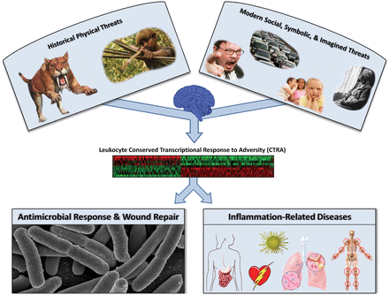
Social Environment and Gene Expression
Social bonds and trust central to humans
(Williams et. al.)
Signals carried on pain neurons
(Eisenberger)
Notes:
Research has shown us that exposure to hostile environment signals pain to human being. We need to be in groups and in early times would die if we weren’t. Researchers have evidence that messages of exclusion and rejection are carried on pain transmitters – the same pathway if you stuck your finger on a hot stove.
As a result nerves fire constantly and ultimately the end result is a damaged would repair system and increased inflammation that can lead to multiple diseases, including death

Slide 6
Development of Psychological Injury*
Experience
Type, frequency, clarity
Antecedents (target/perpetrator)
Moderators
Organizational
Perpetrator
Target
Threatened Needs:
Belonging, control, self-esteem, meaningful existence
Reactions
Immediate, short-term long term
*Adapted from Williams (1997/2001 Model of Ostracism

Slide 7
Antecedents
Target
Perpetrator
Conscientious, high performer, lack of political awareness, strong belief in just world
Anxious, avoidant
Suspicious
Mental illness
Lack of insight
Poor empathy
Attachment issues
Personality disorder
Cultural pressures
Learning

Slide 8
Type of Bullying Experienced
Motive
Exposure
Escalated Conflict
Stress related
Mental Illness
Leadership style
Culture of response to allegations
Predatory and
Acute
Chronic
Frequency
Visibility of actions
Perceived motivation
Clarity – easily defined as bullying

Slide 9
Organizational Moderator: Institutional Betrayal
When the organization does not protect those involved in experiencing and witnessing bullying and harassment a basic belief about safety is violated
Developed by Smith and Freyd (2014) and applied to university lack of response to sexual assaults, and has been applied to WPB (e.g., Pursell Elliot)
In WPB and harassment, the wider the web of betrayal, the greater the moral injury
Ignoring bullying culture
Ignoring requests for help
Not following procedures/legislation
Poorly conducted investigations
Unfair sick leave processes

Slide 10
Individual Moderators
Taking responsibility
Attachment styles, needs for belonging, control, self-esteem, fear response management
Previous experiences
Beliefs about work

Slide 11
Four Basic Human Psychological Needs
The need for attachment (belonging)
The need for control over one’s environment to feel safe (control)
The need for self esteem enhancement & protection (identity)
The need for pleasure & pain avoidance (meaningful life)
Promoting Psychological Safety in the Workplace
Roussow, P.J. (2012).
©Pat Ferris, Ph.D., 2019
Notes:
Humans need to belong. Yet they also commonly leave others out. Animals abandon the weakest to ensure the survival of the fittest. So do kindergartners and ’tweens, softball players and office workers.
Rejection & exclusion hurt. Endured for a long time, ostracism leaves people feeling depressed & worthless, resigned to loneliness or desperate for attention—in extreme cases, suicidal or homicidal.

Slide 12
Reactions to Threats to Basic Needs
Immediate (Alarm) stage:
alarm goes off in the brain and registers physical pain
increased production of adrenaline, noradrenaline
2. Short Term (Coping Attempts):
how to improve their inclusionary status
pay attention to every social cue, cooperate, conform, and obey and look to regain control
3. Long Term (Resignation/Exhaustion)
depleted, depressed, helpless & despairing
ruminative especially on lack of justice in process and search to balance the scales (critical factor in development of injury)
reduced serotonin, less blood flow to PFC, increased production of adrenalin and cortisol, decreased dopamine and GABA
Linda Crockett and Pat Ferris
Promoting Psychological Health and Safety in the Workplace
©Pat Ferris, Ph.D., 2019
Notes:
Belonging, self-esteem, control & meaningful recognition are under attack.
“It doesn’t matter who you’re being rejected by” or “how slight the slight appears” ,

Slide 13
Treatment
Connecting, Assessing, Diagnosing, treatment

Slide 14
The Therapeutic Journey
Connect
Welcoming
Release the story
Empathy
Trust Building
Assessment
Education
Growth
Post Traumatic Growth
Exploring the new self
Insight to learning
Definition of self as resilient
Regaining trust in others
Maintenance
Check-ups and
Tune-ups
Support in times of change and stress
Stabilize
Re engage parasympathetic nervous system
Meditation
Breathing
Art
Hypnosis
Repair
Narrative therapy
Acceptance and Commitment Therapy
Wisdom Therapy
Rumination Focused CBT
CBT
Linda Crockett and Pat Ferris
Promoting Psychological Health and Safety in the Workplace
©Pat Ferris, Ph.D., 2019
Notes:
Resting page

Slide 15
Wampolds Contextual Model
Three pathways or mechanisms that produce benefits in psychotherapy”
a) the real relationship
b) the creation of expectations through explaining the disorder and the treatment that is recommended; and
c) using specific therapeutic techniques to develop health promoting activities
Translated to Treating Targets or Perpetrators
establishing a safe, trusting and real relationship;
education about exposure to and impact of workplace bullying, and the process of treatment; and
working with the client to engage in behavioural and thought changes that improve health and promote resiliency.
Linda Crockett and Pat Ferris
Promoting Psychological Healthy and Safety in the Workplace
©Pat Ferris, Ph.D., 2019

Slide 16
Issues in Connecting: Establishing the Therapeutic Relationship
Client will determine counsellor trustworthiness, expertise, compassion and ability to understand
Role of the counsellor is to be professional, warm, and welcoming, to establish clear boundaries
Strong focus on confidentiality
Extended first interview to facilitate listening to stories that are often long and disjointed (most critical point)
Sense of safety to talk, to be heard and validated is the core of healing for the target – ‘holding’ the client
Agree on goals
Realistic review of achieving justice and counsellor power

Slide 17
Educate
Most clients don’t understand why they were targeted
Blame self
Provide education on why people bully (e.g., personality, culture, stress, learning, mental disorders)
Provide education on why some people become targets
Overly conscientious
Highly competent
Unaware of politics/dynamic
Strong belief in just world
Avoidant
Triggering of perpetrator

Slide 18
Issues in Assessment
May take several sessions and won’t happen easily if the story is not told
Clients find this helpful to understanding and this acts as an educative tool as well
Use validated tools to add objectivity e.g. Negative Acts Questionnaire, Bullying Inventories, Brief Symptom Inventory, Psychiatric Diagnostic and Screening Questionnaire
Provide diagnosis as required

Slide 19
Factors in Assessment
Physical symptoms
Sleep, fatigue, skin disorders, somatic complaints
Psychological symptoms
Rumination, anxiety, depression, obsessions, agoraphobia, trauma related, presence of suicidal ideation/plan
Cognitive symptoms
Poor memory, unable to learn, poor problem solving
Social symptoms
Impoverished/conflictual family and social relationships
Personality changes
Loss of perception of self, shame, guilt, conflictual

Slide 20
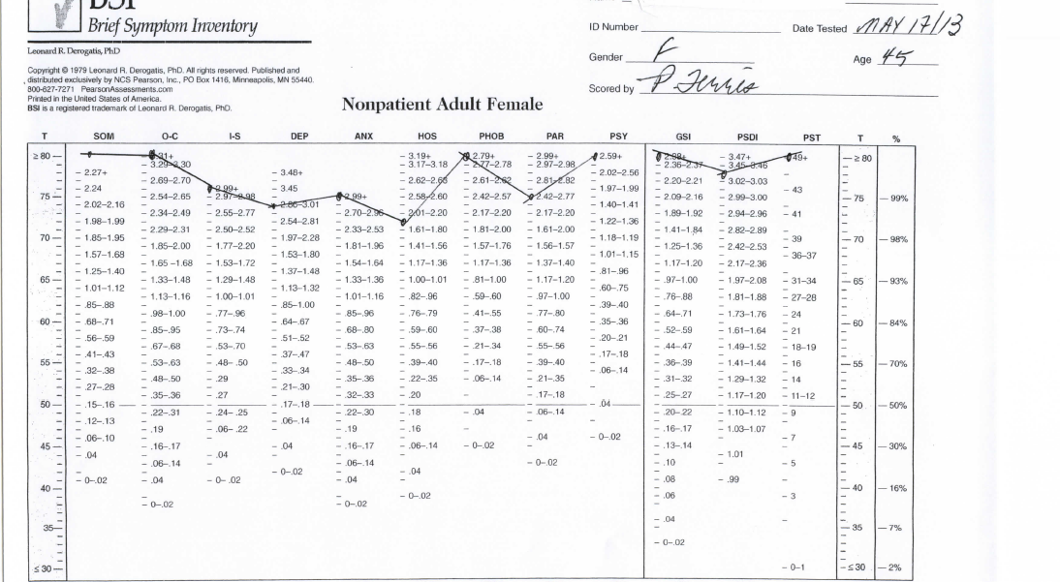
Brief Symptom Inventory Example

Slide 21
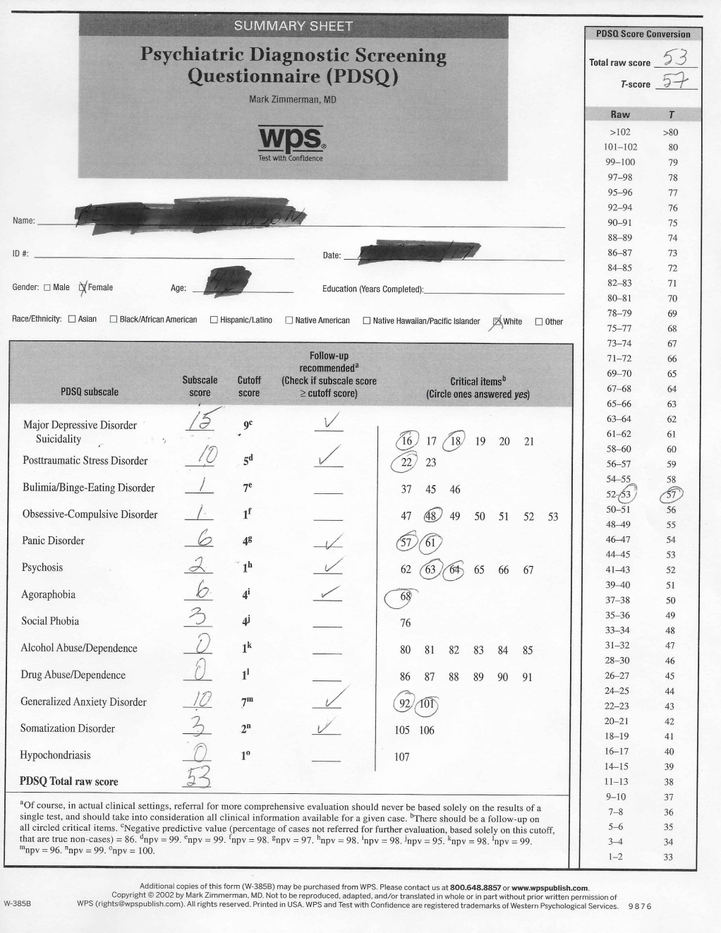
PDSQ

Slide 22
Diagnostic Issues
Adjustment Disorders
Depressive and Anxiety Disorders
Post Traumatic Stress Disorder
Exposure to life threatening situation
Complex Cumulative Trauma
Personality Disorders e.g., Paranoid
Delusional/Psychotic Disorders

Slide 23
Diagnostic Issues | Presentation | Diagnosis
Mild Generally within 3 months of exposure Organizational support | Remains at work Stable personal relationships, Ability to regulate emotions Minimal anxiety, depression Sense of control | Adjustment disorder Occupational Problem
Moderate 3-6 months exposure Failure of organizational supports | Greater disruption in work and personal relationships, physical pain, poor sleep, focus on injustice, rumination on why, avoidant at work or on sick leave | Adjustment disorder, MDE, Anxiety disorder,
Severe Prolonged exposure Organizational failure Late access to appropriate treatment | Unable to work Severe rumination on justice Avoidant Hypervigilant, triggered, distrusting Poor relationships Paranoid/Delusional/persecutory thinking Suicidal ideation, loss of self | Complex PTSD WPB Trauma Moral Injury Rule out psychosis and Delusional Disorder Brief Psychotic Disorder

Slide 24
Treatment: Calm the Sympathetic Nervous and Musculo-Skeletal Systems
Breathing
Meditation
Visualization
Coloring, Art
Music
Exercise
Massage/acupuncture/physiotherapy

Slide 25
Techniques That Develop Health Promoting Behavior
Think about situation is less maladaptive ways
Identifying and relying less on negative schemas (cognitive behavioural strategies), improving interpersonal relationships (interpersonal psychotherapy), accepting that something bad has happened and committing to moving forward (acceptance and commitment treatments), accepting oneself more (self-compassion therapies), and complex trauma therapies

Slide 26
Specific Strategies
Basic needs: small goals such as personal hygiene, a 5 minute walk
Mourn losses through ritual
Rapport; mirroring, empathy “I am here with you.”
Instill hope: resiliency and future vision
Acceptance of situation and commitment to healing
Visualization exercises
Creation of a healing network:
Physician and other treatment providers

Slide 27
Focus on Growth
Work on strengthening beliefs in the self as resilient, reviewing the learning from their experiences, and defining their new path in life.
The counsellor role is one of strengthening the new and growing neural networks in the brain through focused discussions in counselling
Helpful tool is Post Traumatic Growth Inventory

Slide 28
Stability
Agree to check ups
Prepare for minor relapses and normalize

Slide 29
Self Care
Clients can be demanding of attention and resources
Watch your boundaries
Clients can be exhausting
Exhibit high levels of emotions and stress that can be catching
Be careful how many clients you take on
Transference is likely to happen, be prepared for clients to be angry at you
Counter-transference: frustration at client, helplessness, awareness of impact of own experiences
Access to support and clinical supervision

Slide 30
Thank you
©Pat Ferris, Ph.D., 2019

Slide 31
Question & Answer
ABRC
©Pat Ferris, Ph.D., 2019

Slide 32
Contact
Pat Ferris
+1-403-815-6624
ferrispa@telus.net
©Pat Ferris, Ph.D., 2019
Notes:
Add your info here

Slide 33
References and Suggested Reading
Eisenberger, N. I. (2013). Social ties and health: A social neuroscience perspective. Current Opinion in Neurobiology, 23(3), 407-413. doi: 10.1016/j.conb.2013.01.006
Ferris, P. (2004). A preliminary typology of organisational response to allegations of workplace bullying: see no evil, hear no evil, speak no evil. British Journal of Guidance and Counselling, 3(2), 389-395.
Ferris, P. A. (2009). The role of the consulting psychologist in the prevention, detection, and correction of bullying/mobbing in the workplace. Journal of Consulting Psychology: Practice and Research, 61, 169-189. https://doi.org/10.1007/978-981-10-5338-2_3-1 .
Ferris, P.A., Tilley, L., Stephens, F. & Tanchak, S. (2019). The roles of the counselling professional in treating targets and perpetrators of workplace bullying. In P. D’Cruz et al. (eds.), Dignity and Inclusion at Work, Handbooks of Workplace bullying, Emotional Abuse and Harassment 3.

Slide 34
References Con’td
Field, E., & Ferris, P.A. (2019). Diagnosis and treatment: Repairing injuries caused by workplace bullies. In P. D’Cruz et al. (eds.), Dignity and Inclusion at Work, Handbooks of Workplace bullying, Emotional Abuse and Harassment.
Hirigoyen, M. (2011). Healing the wounded soul. In N. Tehrani (Ed.), Workplace bullying: Symptoms and Solutions (pp. 166-178). London, UK: Routledge.
Kreitlow, C. (2015). Beyond symptoms – Harassment and bullying at work. Paper presented at the International Association on Workplace bullying and Harassment Summer School, Calgary, Alberta, August 25, 2015.
Purcell Elliot, G. (2012). Bullying, Mobbing, PTSD and Moral Injury. Retrieved from https://mobbing101.wordpress.com/2013/02/08/bullying-mobbing-ptsd-and-moral-injury/

Slide 35
References Cont’d
Roussow, P.J. (2012). Bullying: A neurobiological perspective. Neuropsychotherapy in Australia, Nov. 15-May, 3-9
Smith, C. & Freyd, J. (2014). Institutional Betrayal. American Psychologist 69(6), 575-587. doi: 10.1037/a0037564
Tedeschi, R. G., & Calhoun, L.G. (1996). The Posttraumatic Growth Inventory: Measuring the positive legacy of trauma. Journal of Traumatic Stress, 9(3), 455–471.
Williams, K. (2015). Ostracism: The power of silence. Keynote address presented at the International Association on Workplace bullying and Harassment Summer School, Calgary, Alberta, August 25, 2015.
Williams, K.D., Forgas, J.P., von Hippel, W. (Eds.). (2005). The social outcast: Ostracism, social exclusion, rejection, and bullying. NY: Taylor & Francis Group

